Slide 1

VAST CHALLENGE 2018 MC3
Team Members:
Supriya Bommisetty(5,8,13)
Renuka Jatoth(4,9)
Chandra Prem Putheti(2,10)
Nagasindhura Vadla(3,11)
Siva Dharma Sastha Madala(7,12)

Slide 2
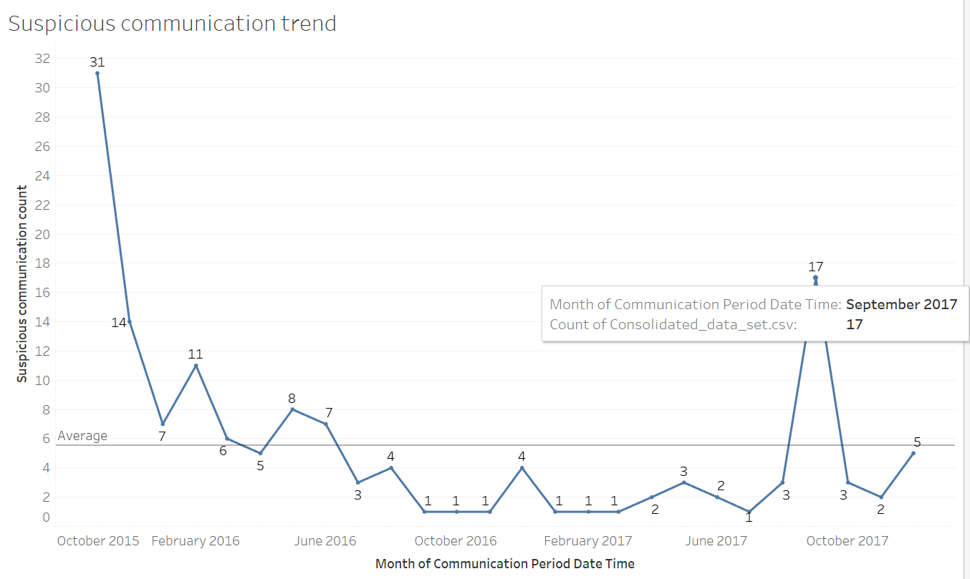
Suspicious communication trend
From the Graph, we can observe that 31 suspicious communications happened in Nov 2015 and In this graph, we can identify in which months suspicious communications happened below average and above average.

Slide 3
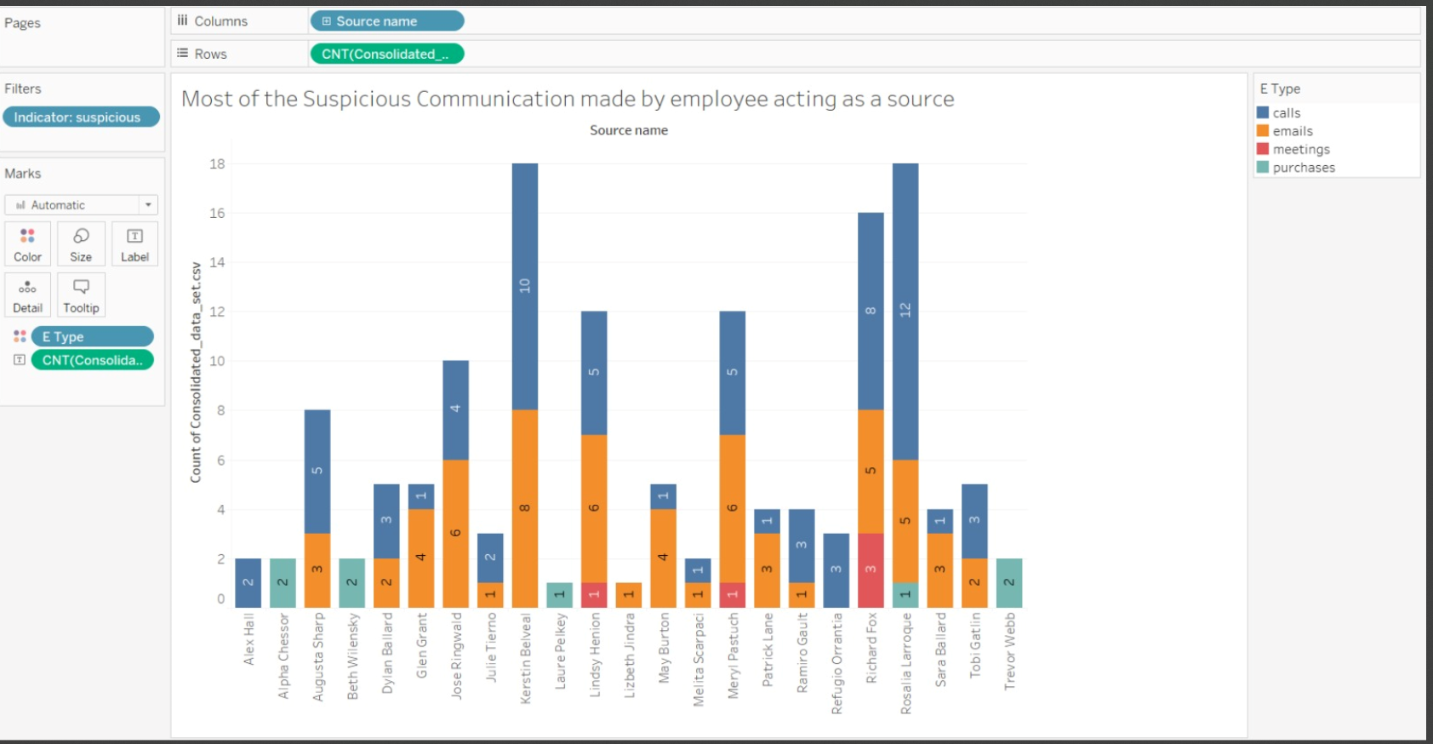
Suspicious communication trend followed by source.
This graph shows what are all the communications made by source.

Slide 4
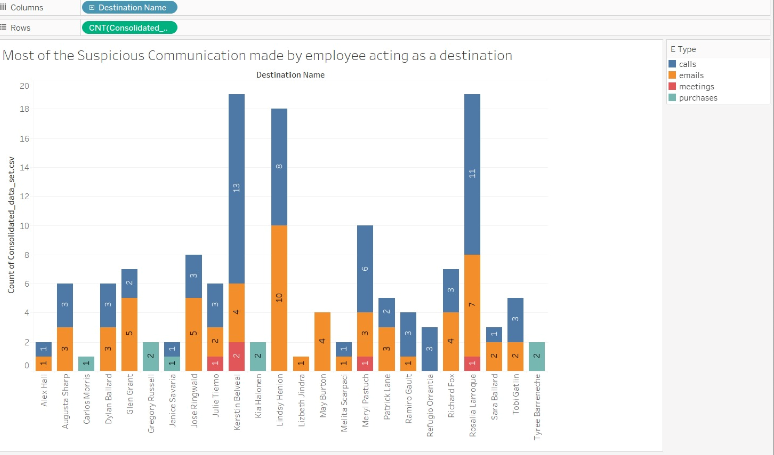
Suspicious communications reached to destination
This graph shows us what are all the communications reached to destination.

Slide 5
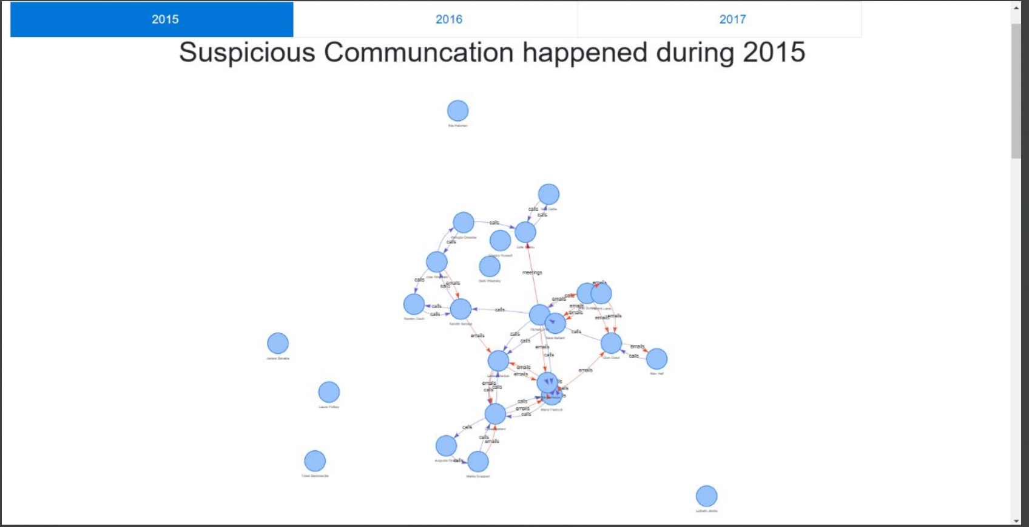
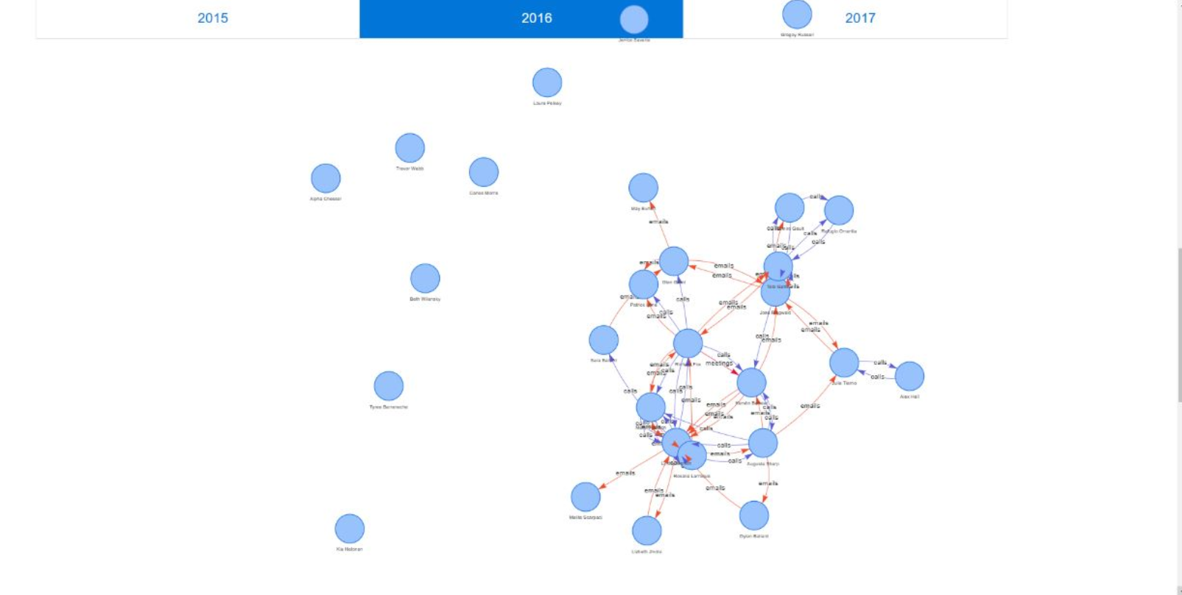
Communications happened in different years

Slide 6
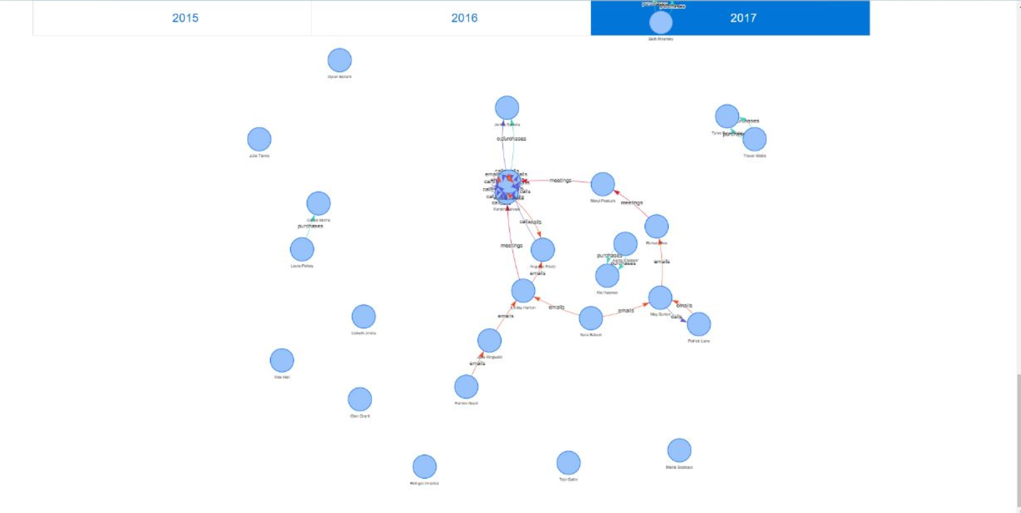
Communications happened in 2017

Slide 7
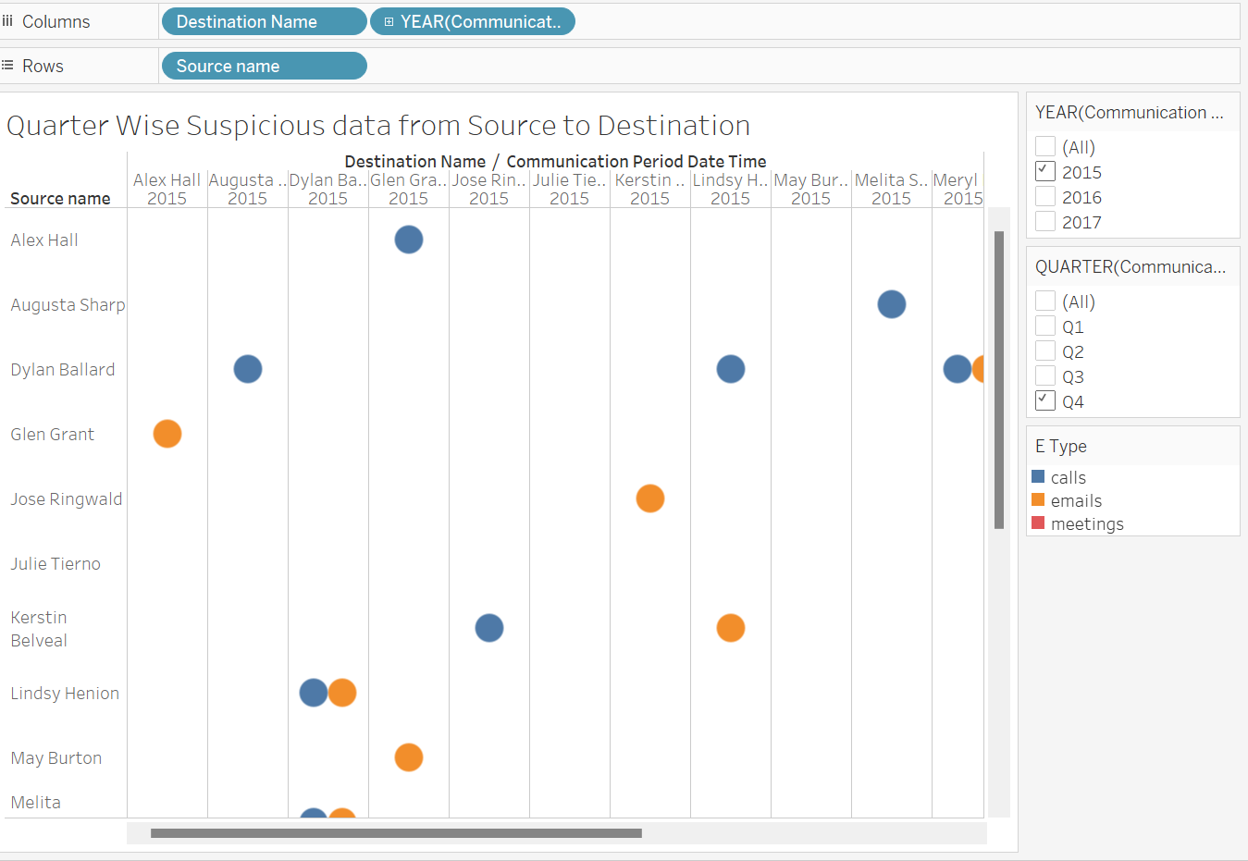
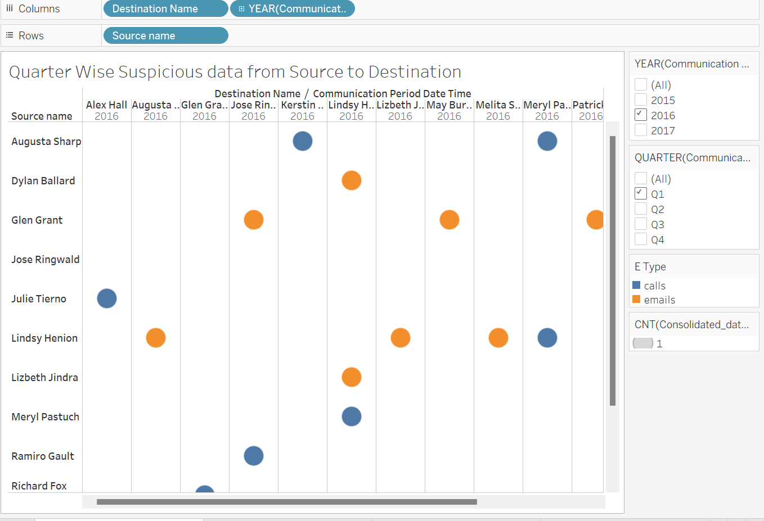
Communications happened in different Quarter

Slide 8
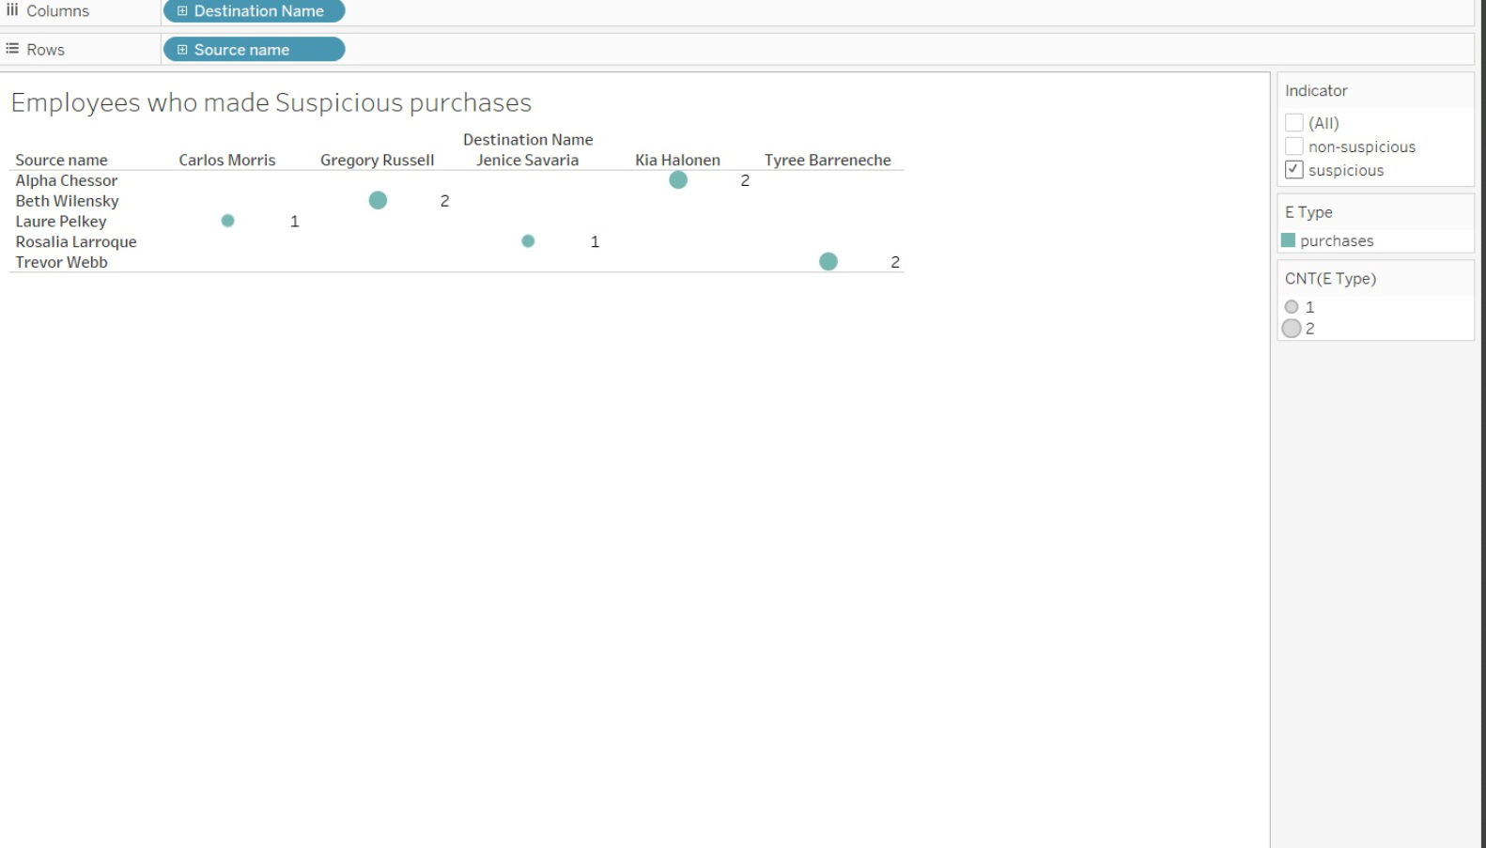
Purchases made by suspicious employees
This graph explains us the how many number of purchases made by employees and made by whom

Slide 9
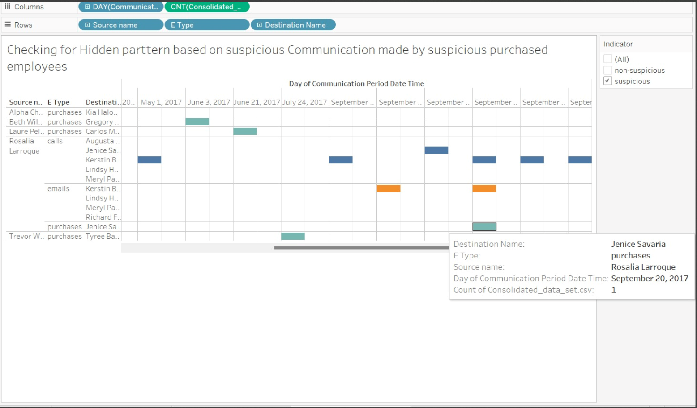
Hiddern pattern Analysis
Checking for the strange pattern happened in the suspicious communication by different employees.
We observed on the same day whenever there is a purchase there is at least one type of communication.

Slide 10
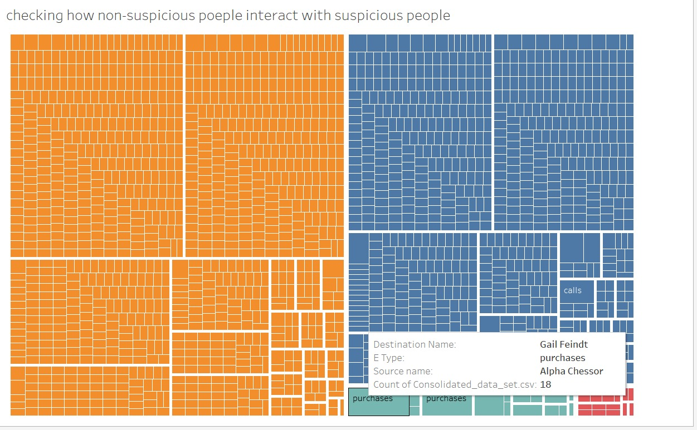
Non suspicious people interaction with suspicious people
This graph tells us the how non suspicious people interacted with suspicious people.
In this graph more number of purchases happened between Alpha Chessor and Richard Fox.

Slide 11
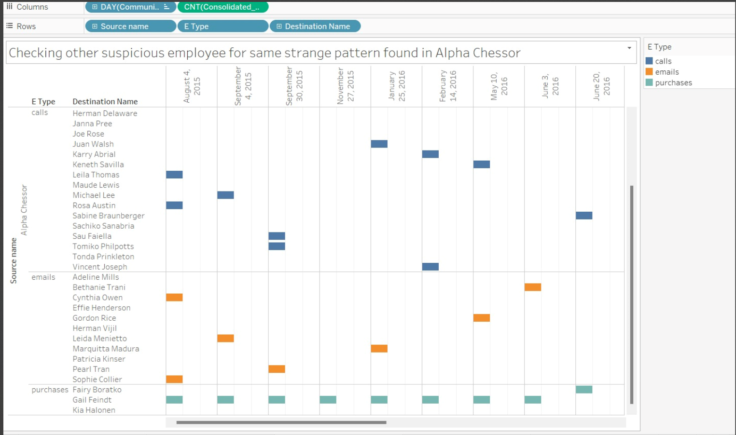
Alpha Chessor communication Analysis
We observed the communications made by Alpha Chessor.
We observed the same pattern made by Rosalia.
Only Gail made all the purchases.

Slide 12
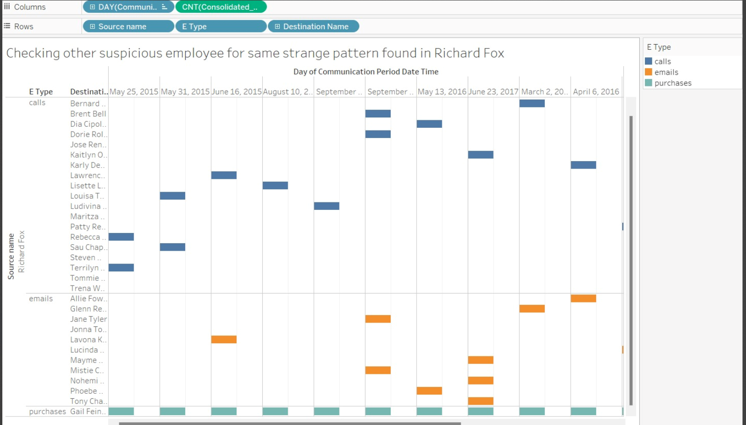
Richard Fox communication Analysis
In this Graph as well, we can observe whenever there is a purchase , there is a communication, and all purchases are reached to destination.

Slide 13
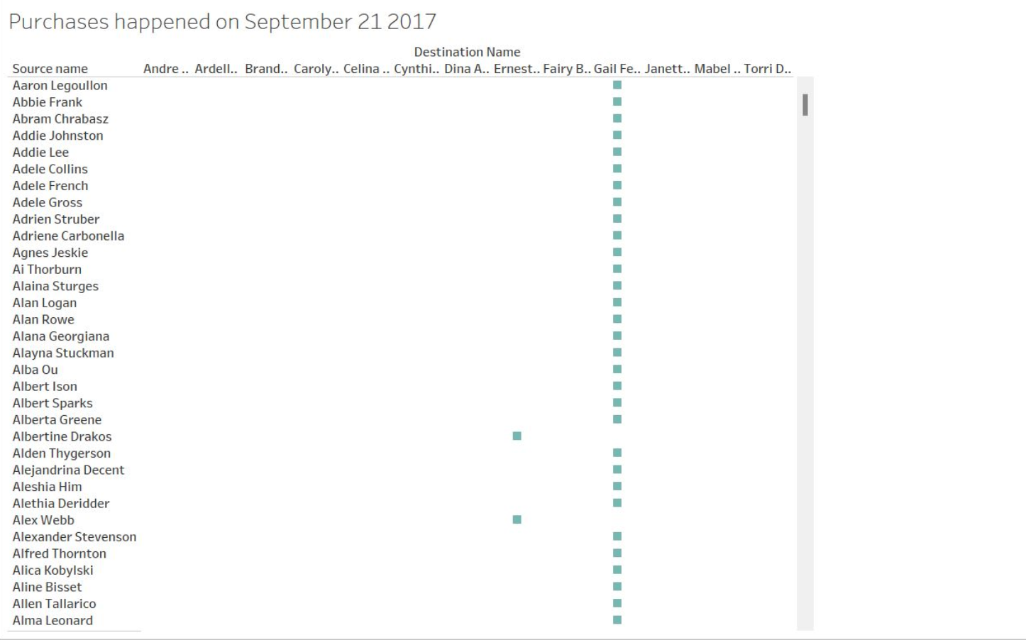
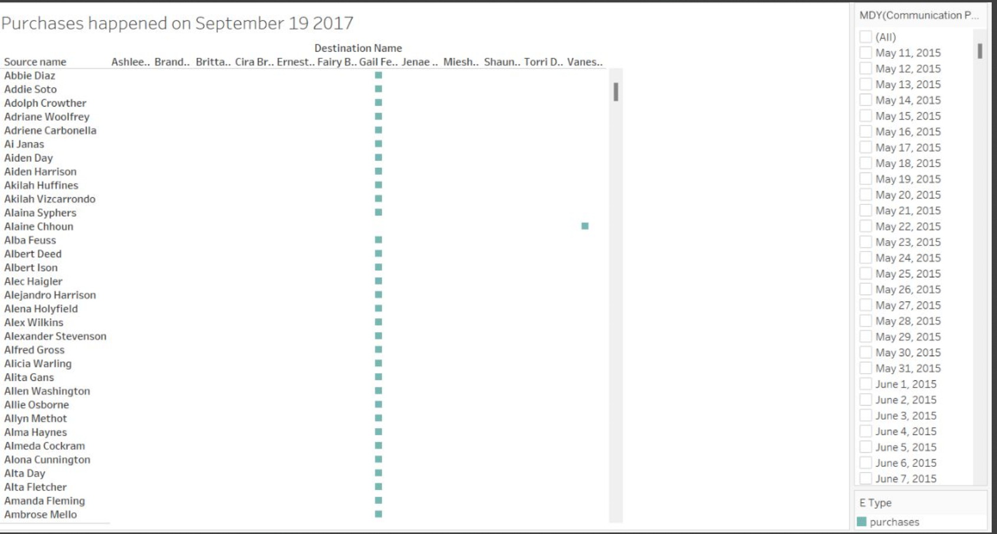
Purchases happened before and after one day

Slide 14
Conclusion
From the above graph, we can observe more number purchases are done by Gail.

Slide 15
THANK YOU

